Slide 1
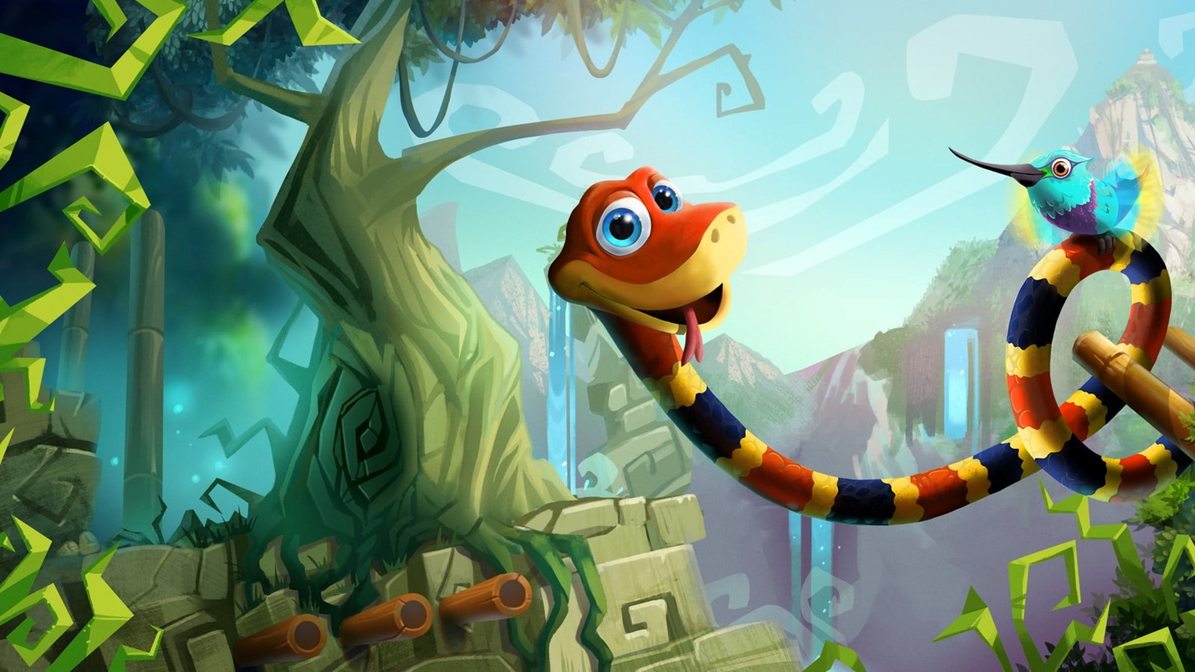
SNAKE GAME USING OPEN CV
BY:
SAJIN AKASH M
GIRIDHARAN A
DHANUSH KUMAR S

Slide 2
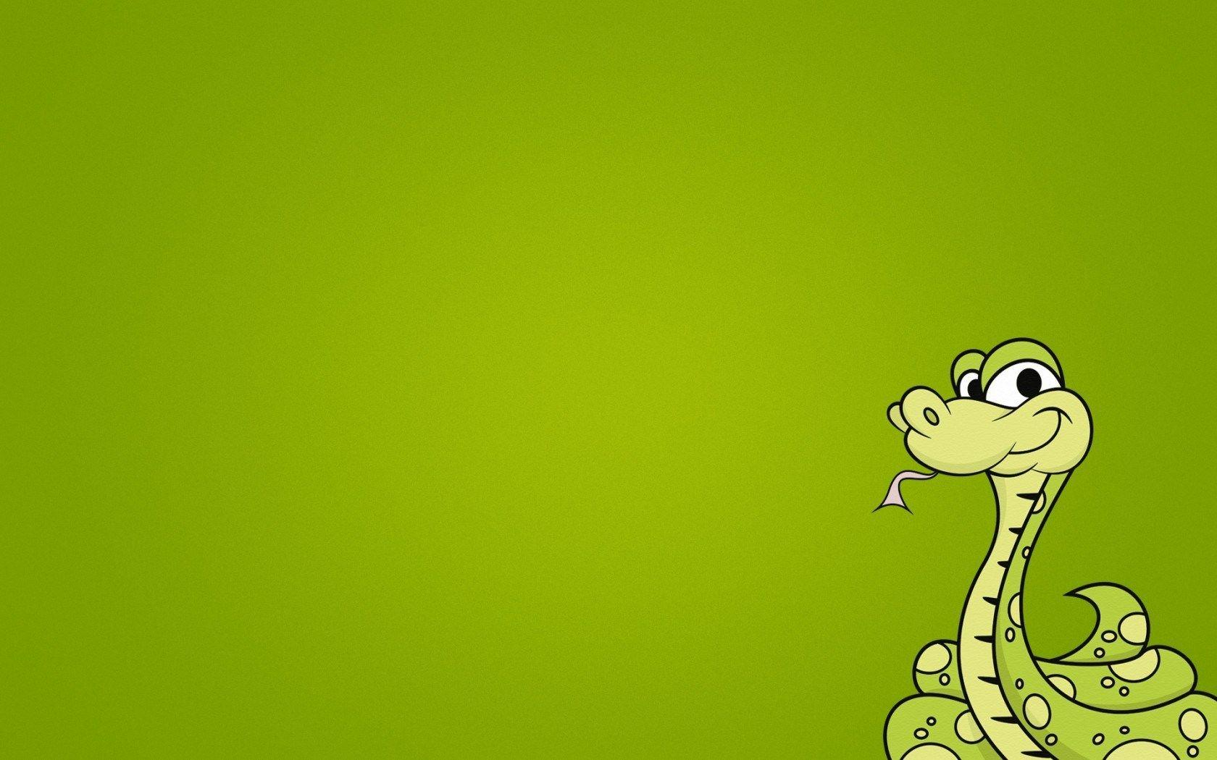

ABSTRACT
This project presents a real-time implementation of the classic Snake game using the OpenCV library in Python.
The Snake game is a popular arcade game where the player controls a snake that grows in length as it consumes food while avoiding collision with itself and the boundaries of the game screen.
implementation leverages computer vision techniques provided by OpenCV for real-time object detection and tracking.
The main components of the implementation include the snake's body segments, food items, collision detection, and score management.

Slide 3
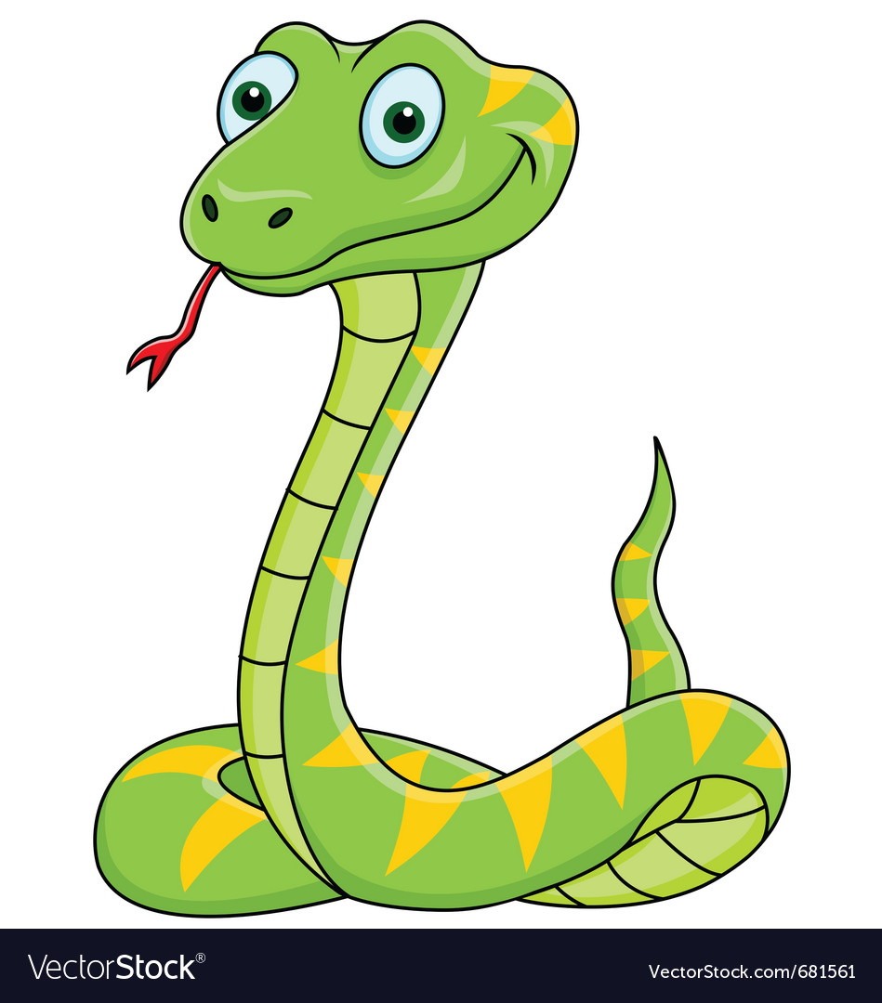
INTRODUCTION
The Snake game holds a special place in the hearts of gamers worldwide, cherished for its addictive gameplay and nostalgic charm.
In our quest to breathe new life into this timeless classic, we turn to the cutting-edge capabilities of OpenCV, a robust library renowned for its prowess in computer vision and image processing.
Through the lens of OpenCV, we will bring the Snake game to life, allowing players to interact with their environment in novel ways and experience gameplay like never before.

Slide 4
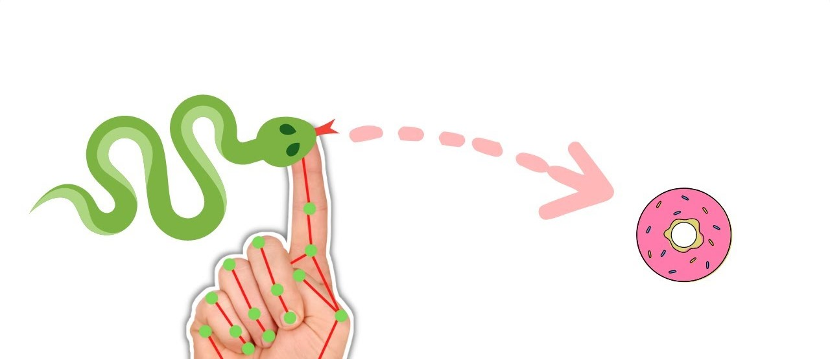
MATERIALS
Computer: You'll need a computer with Python installed to write and execute the code.
Webcam: If you plan to use computer vision techniques for controlling the snake (e.g., hand gestures), you'll need a webcam.
OpenCV Library: Install the OpenCV library, which provides various image processing and computer vision functionalities.
Python IDE or Text Editor: You can use any Python Integrated Development Environment (IDE) or text editor to write your Python code.
METHODS
Setup Environment: Install Python and OpenCV on your computer. You can use package managers like pip to install OpenCV (pip install opencv-python).
Create a Game Window: Use OpenCV to create a window where the Snake game will be displayed. You can define the size of the window and set up any additional parameters.
Initialize Game Variables: Set up variables such as the snake's initial position, direction, length, speed, score, and food position.
Capture Video Frames: If you're using computer vision for controlling the snake, capture video frames from the webcam using OpenCV.

Slide 5

DISCUSSION
Game logic: You'll need to implement the game logic, including:
Moving the snake: The snake moves continuously in a certain direction until the player changes its direction.
Generating food: Food should appear at random locations on the screen.
Collision detection: You need to detect collisions between the snake and the boundaries of the window, as well as between the snake and the food.
Handling user input: You can use OpenCV's event handling mechanisms to capture user input for changing the direction of the snake.
Game loop: Implement a game loop that continuously updates the game state (snake position, food position, etc.) and redraws the screen.
Scoring: Keep track of the player's score, which increases each time the snake eats food.
Game over condition: The game should end if the snake collides with the boundaries of the window or with its own tail. You should display a message indicating that the game is over and the player's final score.

Slide 6
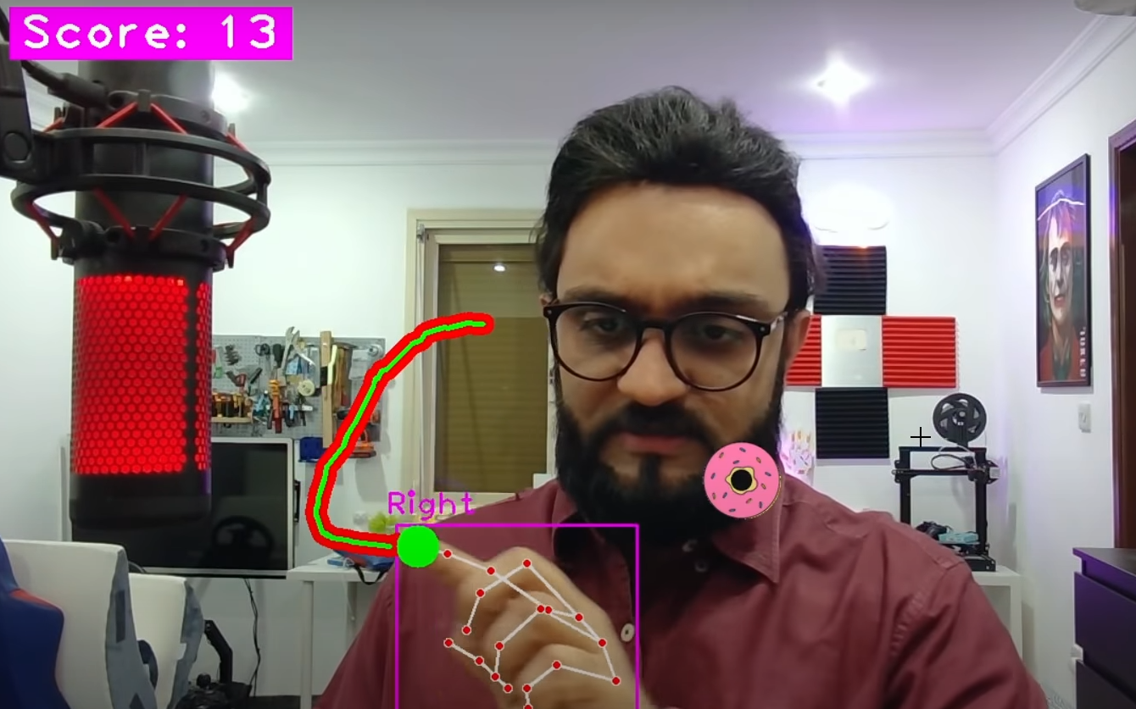
RESULTS
The Snake game opens in a window.
The snake starts moving to the right.
You can control the direction of the snake using the hand.
The objective is to eat the Donut represented by a block.
When the snake eats the donut, its length increases by one block.
If the snake collides with the walls or with itself, the game ends.
The game window closes automatically when the game ends due to collision with the walls or the snake itself

Slide 7
CONCLUSION
Interactivity: OpenCV allows users to interact with the game through keyboard input, enabling them to control the snake's movement.
Graphics and Visualization: OpenCV provides tools for rendering graphics, enabling the creation of visually appealing game elements such as the snake, apple, and game board.
Collision Detection: OpenCV facilitates collision detection between game elements, such as the snake, walls, and apple, enhancing the game's functionality and challenge.
Learning Opportunity: Building the Snake game using OpenCV offers a valuable learning experience in computer vision, game development, and Python programming.
Overall, the Snake game using OpenCV serves as an entertaining and educational project that demonstrates the integration of computer vision techniques into game development, fostering creativity and skill development in programming and computer science.

Slide 8
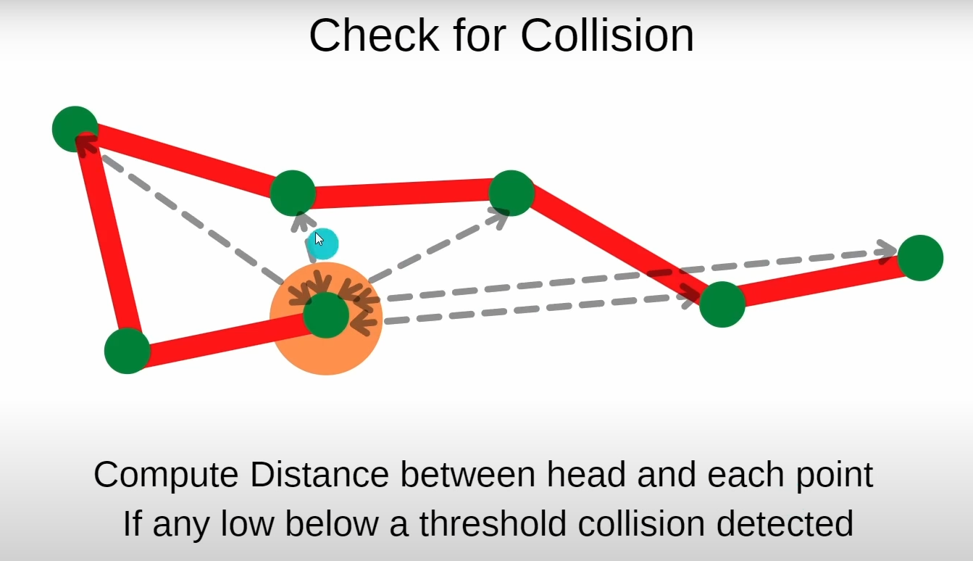
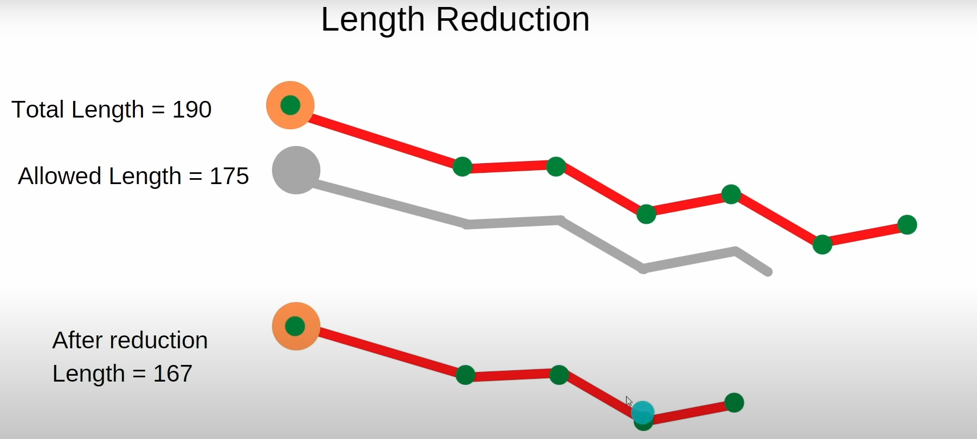
SCOPE
Game Logic and Mechanics:
Implementing the core game logic, including snake movement, apple generation, collision detection, and score tracking.
Graphics and Visualization:
Designing visually appealing graphics for game elements such as the snake, apple, and game board.
Collision Detection and Handling:
Implementing collision detection algorithms to identify interactions between the snake, apple, and game boundaries.
Optimization and Performance:
Optimizing game code for smooth and responsive gameplay.
Minimizing computational overhead to ensure efficient execution, especially for real-time applications.

Slide 9
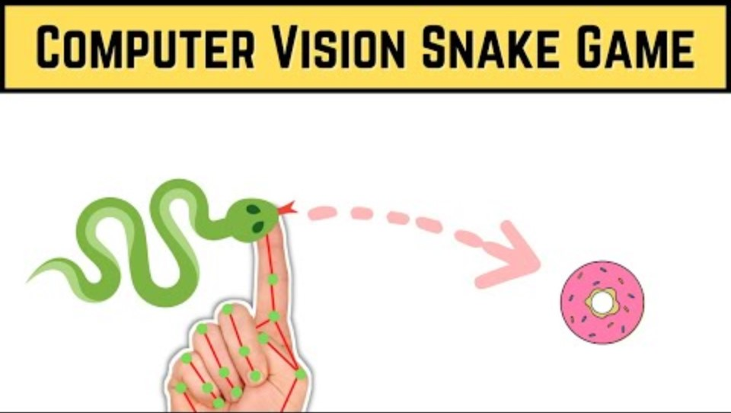
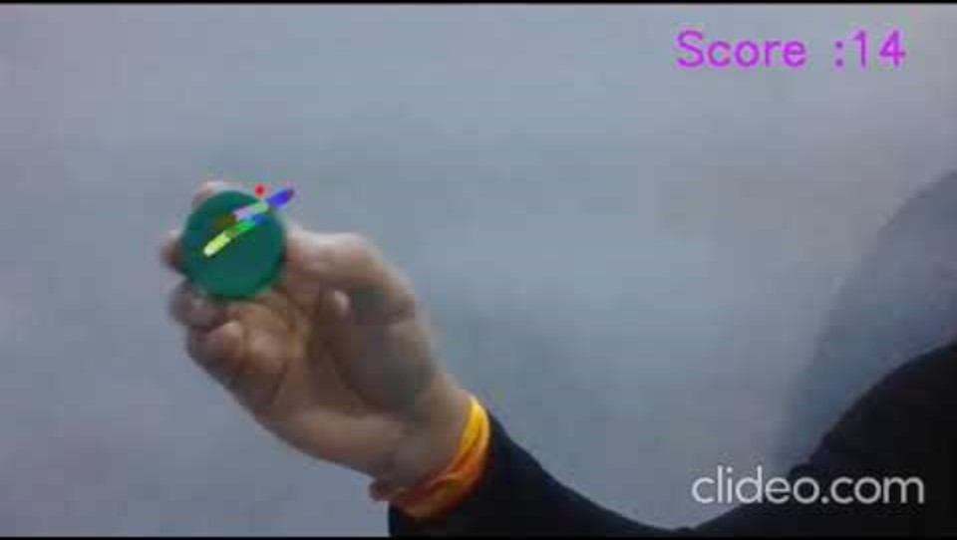
REFERENCES
1.Chatgpt
2.
3.

